Slide 1
IT2757
Server and Services Security Management
- LINUX SID and GID

Slide 2
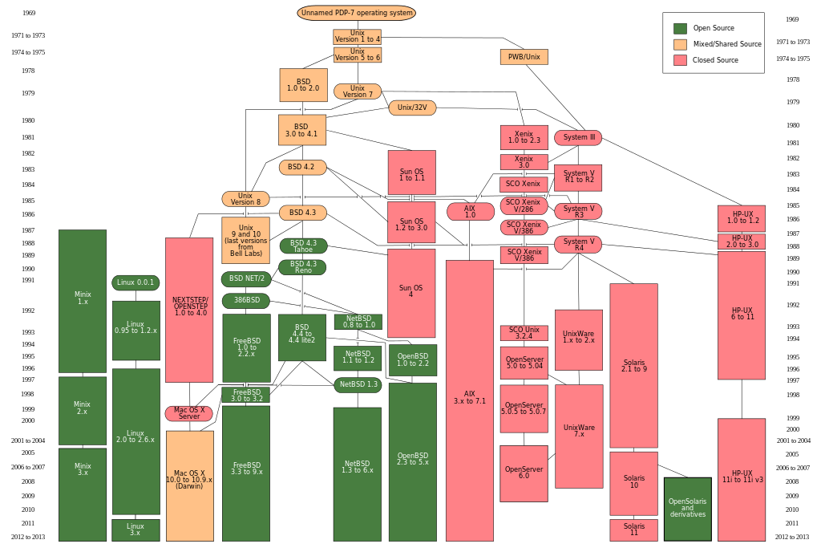
Background: History & Evolution of Unix
http://en.wikipedia.org/wiki/History_of_Unix#/media/File:Unix_history-simple.svg

Slide 3
Architecture of Linux / UNIX
Applications
Shell
Standard Library
Kernel
Hardware
IT2533
3

Slide 4
Architecture of Linux / UNIX
Hardware
  CPU, memory, hard disks and etc.
Kernel
  Provide process management, memory management, I/O management, file management
  Executed in protected Kernel mode
Standard Library
  Open, close, read, write (file operations) and fork (create new processes) function calls
Shell (command line interpreter)
  Ksh, csh, sh, bash
Applications – GUI, web servers, etc

Slide 5
Linux Security
Unix/Linux original DAC (Discretionary Access Control)
  Owner sets policy.
  Policy is represented by permission bits.
  Programs launched by a user run with all of the rights of that user, whether they need them or not.
  There is also a superuser, which is not restricted by DAC at all.
Extended Security Features
  Access Control List (ACL)
  Network security: Netfilters with Iptables
  Linux Security Modules:
    SELinux: Supports Mandatory Access Control (MAC)
    Smack: Lightweight MAC in embedded system
    AppArmor: MAC with security policy applied to pathnames
    TOMOYO: Another path-based MAC
Notes:
The Linux Security Modules (LSM) API implements hooks at all security-critical points within the kernel. A user of the framework (an “LSM”) can register with the API and receive callbacks from these hooks. All security-relevant information is safely passed to the LSM, avoiding race conditions, and the LSM may deny the operation. This is similar to the Netfilter hook-based API, although applied to the general kernel.
The LSM API allows different security models to be plugged into the kernel—typically access control frameworks. To ensure compatibility with existing applications, the LSM hooks are placed so that the Unix DAC checks are performed first, and only if they succeed, is LSM code invoked.
Security Enhanced Linux (SELinux) is an implementation of fine-grained Mandatory Access Control (MAC) designed to meet a wide range of security requirements, from general purpose use, through to government and military systems which manage classified information. MAC security differs from DAC in that the security policy is administered centrally, and users do not administer policy for their own resources. This helps contain attacks which exploit userland software bugs and misconfiguration.
In SELinux, all objects on the system, such as files and processes, are assigned security labels. All security-relevant interactions between entities on the system are hooked by LSM and passed to the SELinux module, which consults its security policy to determine whether the operation should continue. The SELinux security policy is loaded from userland, and may be modified to meet a range of different security goals. Many previous MAC schemes had fixed policies, which limited their application to general purpose computing.
SELinux is implemented as a standard feature in Fedora-based distributions, and widely deployed.
The Smack LSM was designed to provide a simple form of MAC security, in response to the relative complexity of SELinux. It's also implemented as a label-based scheme with a customizable policy. Smack is part of theTizen security architecture and has seen adoption generally in the embedded space.

Slide 6
Background: A Typical Unix File System Hierarchy
/ UNIX kernel programs and few startup scripts
/bin UNIX core/basic command files
/etc System and network administration command files
/dev Device files map to different devices like memory, hard disks, keyboard, console and network interfaces
/tmp temporary working files required by system and network administration commands, the only directory that read/write by any logon users
/usr Most of the application software
/home user directories for users’ data
/opt Third-party and-on software e.g. StarOffice
/var Garden-variety administrative logs, mail and news

Slide 7
Unix File Permissions Fundamentals (revisited)
File permissions are read(r), write(w) and execute(x)
Each file or directory has a separate set of file permissions
-rwxr-xr-x 1 joe 19876 Apr 17 20 /usr/bin/passwd
Others authenticated users of the system
Group members of the owner in the same group directory
Owner of the file or directory
d directory
l symbolic link
b block special
c character special
p named pipe special
s local socket special

Slide 8
UNIX Operating System DAC Security Model
Reference Monitor
Concept
Object Permissions
(owner, group, others)
Subject
(a process represents an owner in a group)
Reference Monitor
Objects
(files, directories)

Slide 9
Reference Monitor
UNIX Kernel performs the function of a reference monitor to provide access control to objects.
A subject, a process owned by a user and belongs to a group, needs to go through the reference monitor to access the required objects (UNIX system resources)
The reference monitor looks up the owner, group and others permissions of the object and grant/deny access of the process to the object.
  In Linux, SELinux enhanced traditional DAC model.
Reference Monitor is an requirement in Class B3 – Security Domains of Trusted Computer System Evaluation Criteria

Slide 10
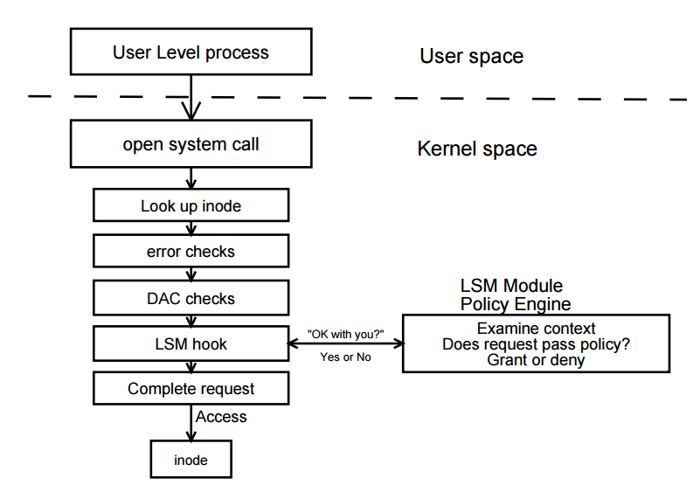
Linux Security Module Architecture
http://www.kroah.com/linux/talks/ols_2002_lsm_paper/lsm.pdf

Slide 11
Typical User Login Process
UNIX stores hashed passwords in a password files /etc/shadow and allows only root to have read access
  Each user can change his/her password through /etc/passwd program through using setuid
When a user logs in through the login process, login process asks for a login name and a password.
It then hashed the user-entered password and compare it with the respective hashed passwords stored in /etc/shadow.
Storing hashed passwords is to prevent exposure of the original password.
56 bit “salt” is added to defend against ( or to delay) rainbow table attack.

Slide 12
Format of the entry in /etc/shadow
username:passwd:last:may:must:warn:expire:disable:reserved
User login name
salt and hashed password OR a status exception value
  "$id$salt$encrypted", where "$id" is the hashing algorithm used (On linux, "$1$" stands for MD5, "$2$" is Blowfish, "$5$" is SHA-256 and "$6$" is SHA-512, etc. Other Unix may have different values).
  "NP" or "!" or null - No password, the account has no password.
  "LK" or "*" - the account is Locked, user will be unable to log-in
  "!!" - the password has expired
Days since epoch (since Jan 1, 1970) of last password change
Days until password may be changed
Days before password must be changed
Days to warn users for password expiration
Days since Jan 1, 1970 that the account has been disabled

Slide 13
User and Group Databases
User database: /etc/passwd and /etc/shadow
    Maps name to UID, GID, home directory, and login shell
    Maps name to password and expiration
Group database: /etc/group and /etc/gshadow
  Maps group to GID and user members
  Maps group to password and group administrators
Management: system-config-users and/or command line tools

Slide 14
User and Group Databases
  The /etc/passwd file contains seven fields.
  The /etc/group file contains four fields.
  The /etc/shadow file is referenced when someone logs in: the file contains a mapping of a user name to a password. For example list of the fields, see the man page: shadow(5)

Slide 15
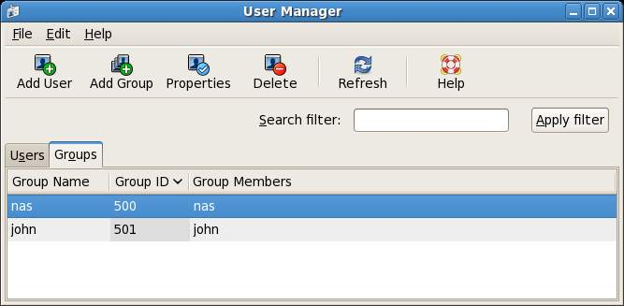

Slide 16
User and Group Databases
System Users and Groups
  Root : UID=0, GID=0
  System user: 0<UID<500, 1<GID<500
  Normal User: UID start from 500, normally smaller than 999
User Management
  System-config-users is a graphical tools that can manage both users and groups in these databases. Command line tools will be presented over the next several pages (useradd,passwd.usermod, userdel, chage, groupadd, groupdel, gpasswd, etc.)

Slide 17
Adding a New User Account
useradd [options] username
Set account password using passwd
  The command-line utility useradd provides a simple method for adding new users to the system:
  [root@stationX ~] # useradd anthony
  [root@stationX ~] # passwd anthony
When adding an account with useradd, you should consider using the –m option to create the user’s home folder.

Slide 18
Adding a New User Account
When you need to add several users, you can use the newusers command with a simple script file.
    [root@stationX ~] # cat myusers
    Alice:password:500:500:Alice:/home/alice:/bin/bash
    Bob:dooow0rd:501:501:Bob:/home/bob:bin/bash
    [root@stationX ~] # newusers myusers
To configure whether or not use SHA or MD5 to generate password:
  /etc/login.defs needs an entry like this:
  ENCRYPT_METHOD SHA512

Slide 19
Modifying / Deleting User Account
To change fields in a user’s /etc/passwd entry you can:
  Edit the file by hand with vipw
  Use usermod [option] username
To remove a user either:
  Manually remove the user from /etc/passwd, /etc/group, /etc/gshadow, /var/spool/mail, etc.
  Use userdel[-r] username

Slide 20
Usermod command
Command: usermod options
  -e date
    Set date on which the account will expire and be disabled.
  -g group
    Change the primary group
  -G group,[. . .]
    A comma separated list of All supplementary groups for the user.
  -a –G group
    Append the group to the user’s list if auxiliary groups.
When adding user access to a supplementary group with the –G option, you must list all groups to which a user belongs, or include the –a option to append the user.

Slide 21
userdel
userdel deletes a user from the system. It may be prudent to lock the user’s account first with usermod –L, and to delay deletion of the user’s account until you are sure that none of the files in the user’s home directory are still needed.
When deleting an account with userdel, you should consider using the –r option.

Slide 22
Group Add/Delete
Creation Group
  groupadd [-g uid] auxgroup
Add users to group (either):
  #usermod –aG auxgroup username
  #gpassed –a username auxgroup
  #vigr
Rename/Delete: groupmod and groupdel

Slide 23
Group Add
New groups may be created by hand-editing the file /etc/group with vigr or by using groupadd. The basic syntax for groupadd is very simple:
[root@stationX ~] # groupadd groupname
[root@stationX ~] # groupadd –g 201 groupname

Slide 24
Password Aging Policies
  The chage command is used to modify password aging. You may set the maximum amount of time that a password is considered valid before the system will force the user to change his password.
  This prevents users from changing their password when required to by the system, and then changing it right back to the old value. chage changes the number of days between password changes and the date of the last password change. This information is used by the system to determine when a user must change her password.

Slide 25
Chage
  [root@stationX ~] # chage [options] username
  Common options used with the chage command:
      -m days minimum days between password changes
      -M days maximum days between password changes
      -d days set the day when the password was last changed.
      -E date expire the account on this date (yyyy-mm-dd format)
  [root@stationX ~] # chage username
  Demo

Slide 26
The Quota System
Quota allows you to specify limits on two aspects of disk storage:
  the number of inodes
  the number of disk
Quota is handled on a per user, per file system basis. If there is more than one file system which a user is expected to create files, then quota must be set for each file system separately.
Initialization
  Partition mount options: usrquota, grpquota
  Initialize database: quotacheck –cugm/filesystem
  Start or stop quotas: quotaon, quotaoff

Slide 27
Configuring the Quota System
Define partition options:
For a partition to implement quotas, it must be mounted with the usrquota or grpquota options. Edit /etc/fstab, adding the usrquota option to the /home partition:
Remount the file system.
  [root@stationX ~] # mount –o remount,rw /
However, if the file system is in use, you have to reboot.
... /dev/hda2 /home ext3 defaults,usrquota,grpquota 0 0...

Slide 28
Configuring the Quota System
Create/Update the database:
  The disk usage database is stored within a partition’s top-level directory in specially named binary files, aquota.user and aquota.group. Use quotacheck –cmuga to create a new user and group quota file.
Starting and stopping quotas with quotaon and quotaoff :
  [root@stationX ~] # quotaon / (Noted here / represent a partition)
  OR
  [root@stationX ~] # quotaon -a
  These commands rarely need to be run in practice, because they are included within Red Hat Enterprise Linux initialization script /etc/rc.d/rc.sysinit.

Slide 29
Managing Quota
Configuration (Implementation)
  Edit quotas in vi editor: edquota username
  Edit from command:
    setquota username BlkSoft BlkHard FileSoft FileHard filesys
    Example setquota eddy 4396 5120 40 50 /
Reporting
  User inspection: quota
  Quota overviews: repquota
  Miscellaneous utilities: warnquota

Slide 30
Demo

Slide 31
Reflection
What are the different tasks in administration of users in Linux?
How each task be executed by Linux commands?
What is Linux filesystem quota?
How to setup the filesystem quota?
What are the tasks to manage the quota for each user?

Slide 32
Summary
Manage user and group accounts in Linux
Manage file system quotas to protect availability of file system

Slide 33
THE END

